Slide 1
Salesforce Sales Cloud Overview
Trainers :
Utkarsha Bose
Piyali Nag

Slide 2

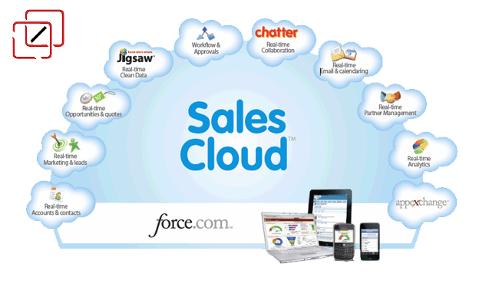

Copyright © 2019 Deloitte Development LLC. All rights reserved.

Slide 3
Contents
Sales Cloud Overview When to use Sales Cloud Benefits of Sales Cloud Standard Objects in Sales Standard Capabilities in Sales Reports and Dashboard Chatter End to End Flow of Sales | 1 2 3 4 5 8 9 10
Copyright © 2019 Deloitte Development LLC. All rights reserved.

Slide 4




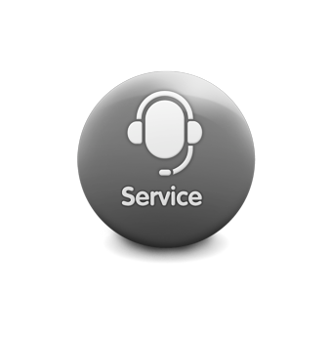




Sales Cloud Overview
Salesforce Sales Cloud is a customer relationship management (CRM) platform designed to support sales, marketing and customer support in both B2B and B2C contexts. It is focused on enhancing the effectiveness of the sales team of an organization.
Your Customer
Copyright © 2019 Deloitte Development LLC. All rights reserved.

Slide 5
When to use Sales Cloud?
When customer information is all over the place
When we are losing critical information
When we don't have a plan to scale fast
When running reports is a painful and tedious process
When business has unique needs
Copyright © 2019 Deloitte Development LLC. All rights reserved.

Slide 6
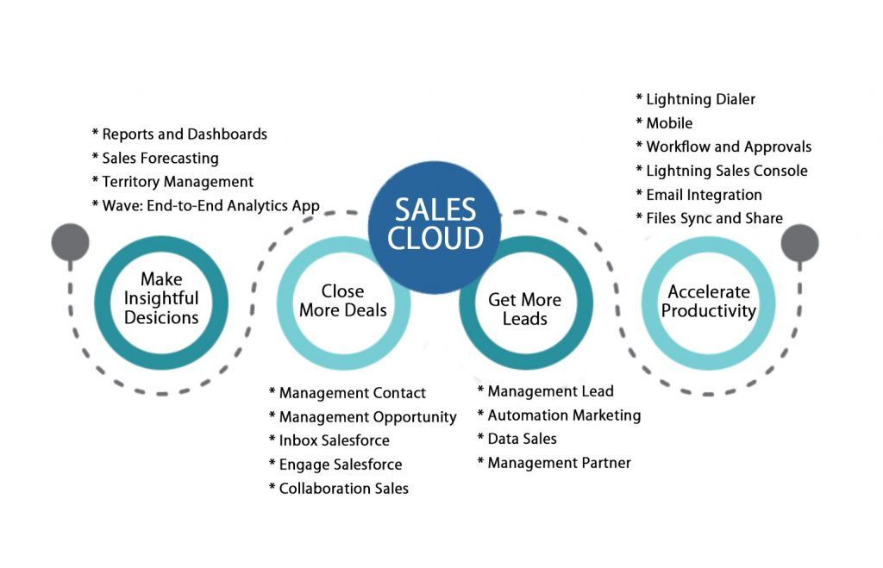
Benefits of Sales Cloud
Personalization of the sales process
Increased opportunities
Accurate forecasting
Drives steady growth
Streamlines business processes
Makes the sales process faster
Copyright © 2019 Deloitte Development LLC. All rights reserved.

Slide 7








Standard Objects in Sales
Campaign
Lead
Account
Opportunity
Contact
Quote
Product
Pricebook
4
Copyright © 2019 Deloitte Development LLC. All rights reserved.

Slide 8
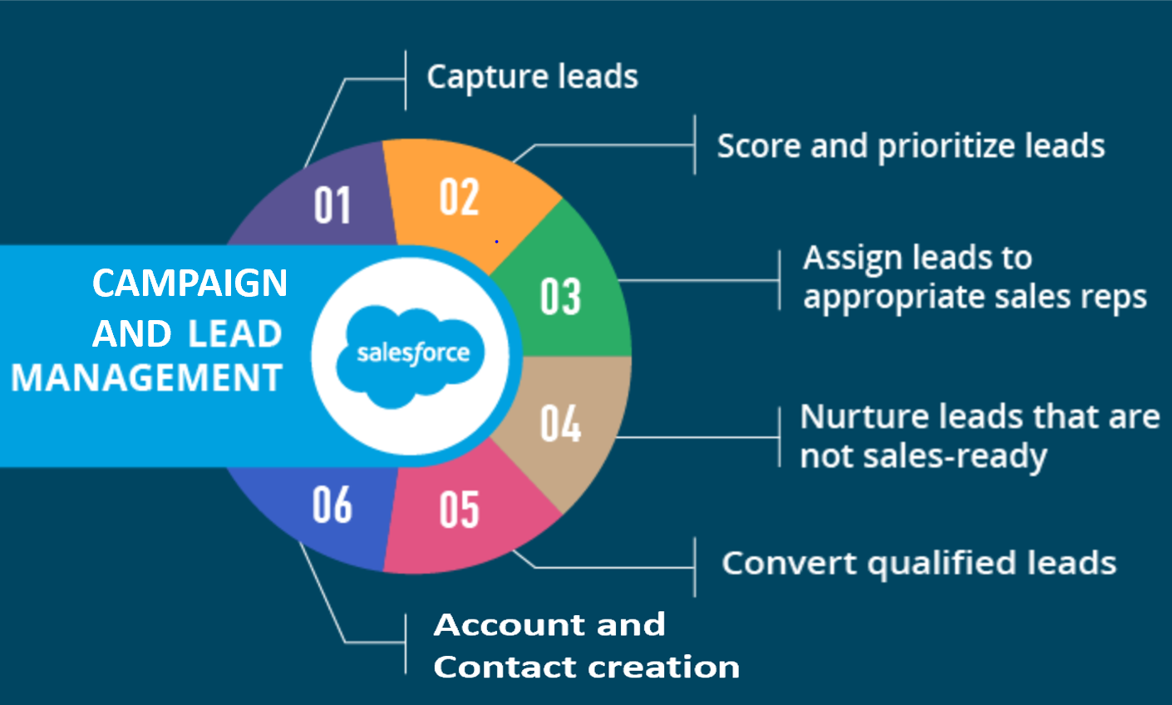
Standard Capabilities in Sales
Campaign Management : Campaign can be organized as Seminar ,advertisement or direct email for marketing to existing Lead/contact and also for new lead generation
Lead Creation : Lead is created from different sources
Lead Nurturing : A potential customer with whom you keep contact to make them sales qualified.
Lead Routing : Lead routing involves creating Lead Assignment Rules
Lead Conversion : Qualified Leads are converted into Account, opportunity and Contact
Account & Contact Creation : Accounts are companies that you're doing business with, and contacts are the people who work for them
5
Copyright © 2019 Deloitte Development LLC. All rights reserved.

Slide 9
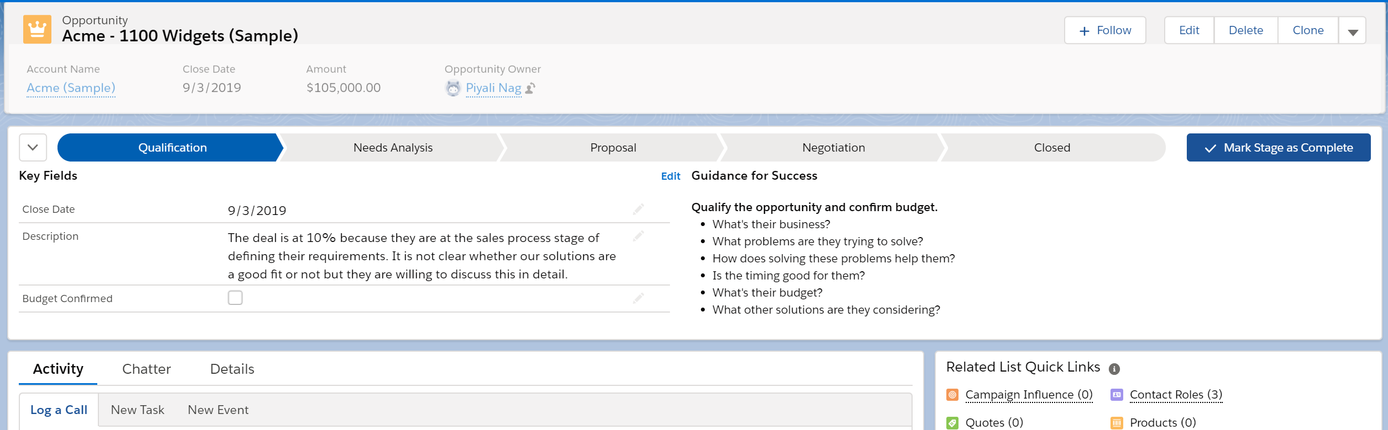
Standard Capabilities in Sales (continued)
Opportunity Stages: Opportunity is something associated with revenue. It moves through various stages to get refined
Opportunity Forecasting and Pipeline: Forecasts are expressions of expected sales revenue. They help sales teams predict and plan their sales cycle from pipeline to closed sales, and to manage sales expectations throughout the company
Opportunity Closure: A closed-won opportunity is the stage of the sales cycle in which a contact has inked the deal and become a customer
6
Copyright © 2019 Deloitte Development LLC. All rights reserved.

Slide 10
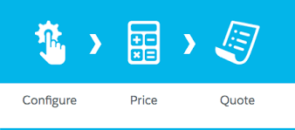
Standard Capabilities in Sales (continued)
Pricing : A Pricebook gives you a list price for all products. You can also set discounts on individual products or product groups. When you add products to a quote, your quote automatically calculates the product prices.
Quote creation & Product Configuration: Quotes in Salesforce represent the proposed prices of your company’s products and services. You create a quote from an opportunity and its products. After you create a quote, you add products to it.
Quote Approval: The process starts with an initial quote request and end with an approved quote.
Order and Contract Management: A contract is generated from an Order to manage subscription products that your customers have purchased.
7
Copyright © 2019 Deloitte Development LLC. All rights reserved.

Slide 11
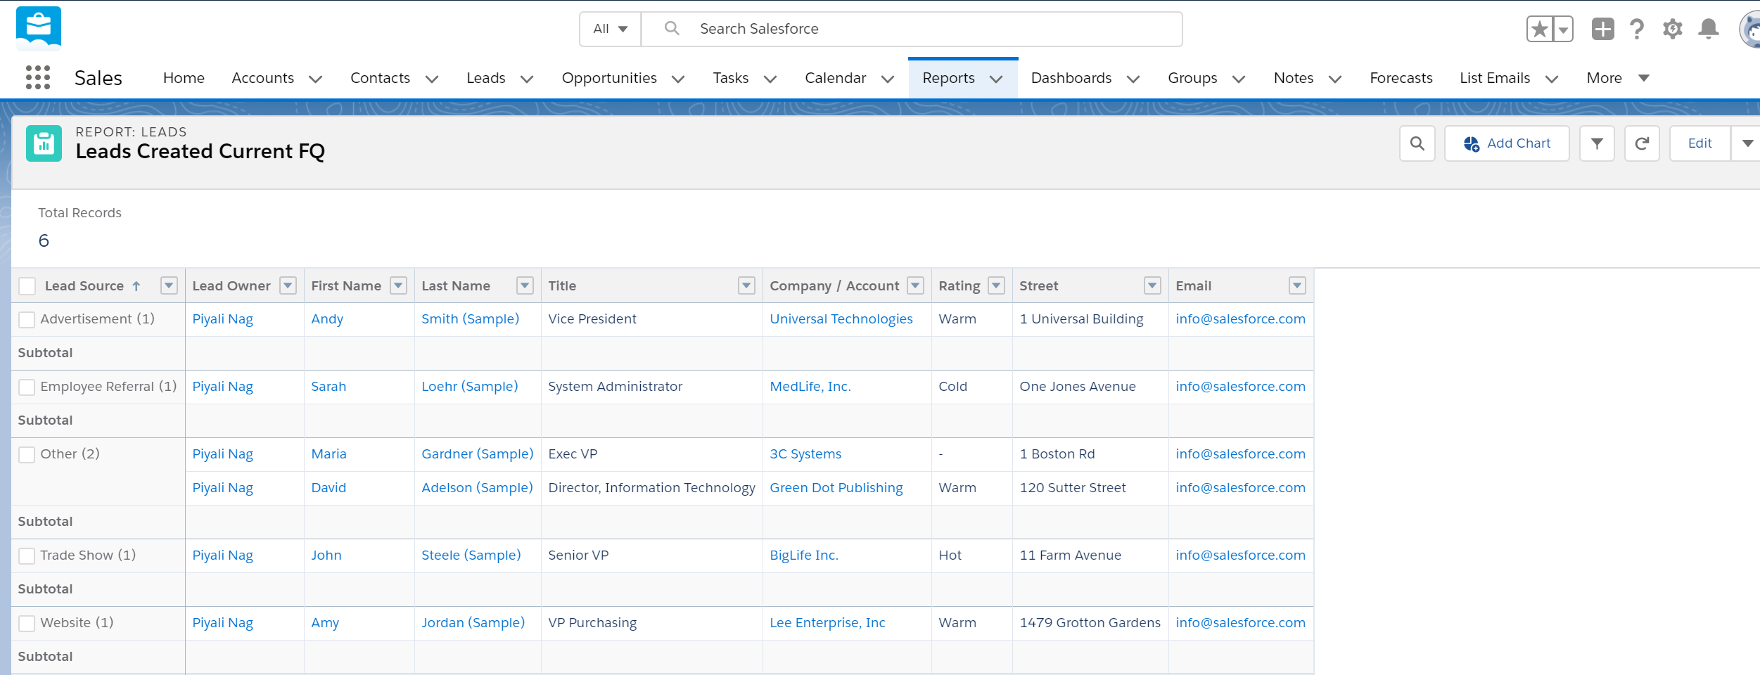
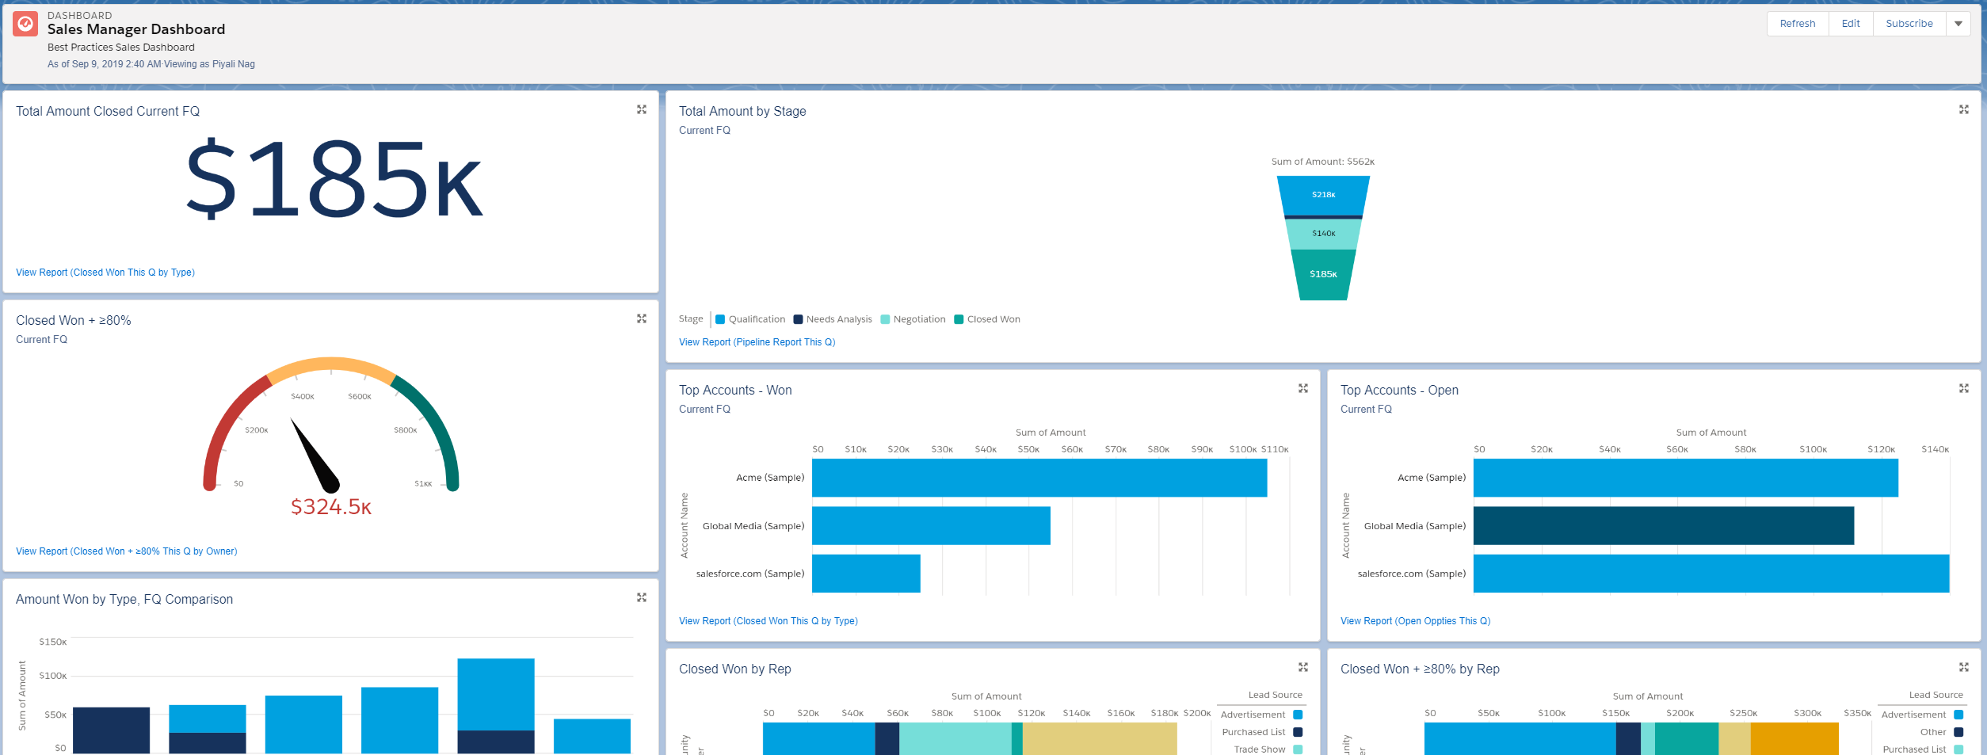
Reports and Dashboards
A report is a list of records that meet the criteria you define. It’s displayed in rows and columns, and can be filtered, grouped, or displayed in a graphical chart.
A dashboard is a visual display of key metrics and trends for records in your org
Every report /Dashboard is stored in a folder and folder access can be controlled.
The relationship between a dashboard component and report is 1:1; for each dashboard component, there is a single underlying report.
8
Copyright © 2019 Deloitte Development LLC. All rights reserved.

Slide 12
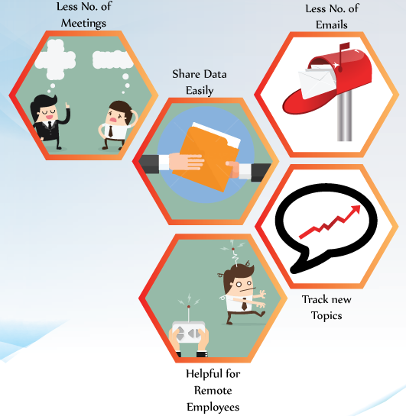
Chatter
Chatter provides the functionality to collaborate with many people. By using Chatter one can easily connect to their coworkers and share the information accordingly.
Chatter Groups-In the group we can add the members and these members can communicate to each other. These groups can be public or private. If the group is public then any member can see the comments ,posts and files and if the group is private then only group members are able to see the comments ,posts and files.
9
Copyright © 2019 Deloitte Development LLC. All rights reserved.

Slide 13
End to End Flow of Sales
Demand to Opportunity
Campaign are organized from where the Leads generation happens. Leads are entered in the SFDC.
Leads get assigned to sales representatives based on Lead assignment rules, and they work to qualify them.
Qualified Leads undergo conversion to create an Account, Opportunity and Contact.
Opportunity to Closure:
Opportunities move through the various stages and the sales representative tries to win the deal .
When Closed Lost, Opportunity Lost Reason is captured so that these data can be reported and analyzed
Quote to Cash:
A Pricebook is configured. Quotes are created on refined Opportunities and go through the Approval process.
To ease the approval process, DocuSign Plug-in provides e-Sign facility. With these the deal gets finalized and the opportunity is Won and the Orders get generated.
Contract is generated from the Order to manage subscription products which can be extended or renewed.
10
Copyright © 2019 Deloitte Development LLC. All rights reserved.

Slide 14
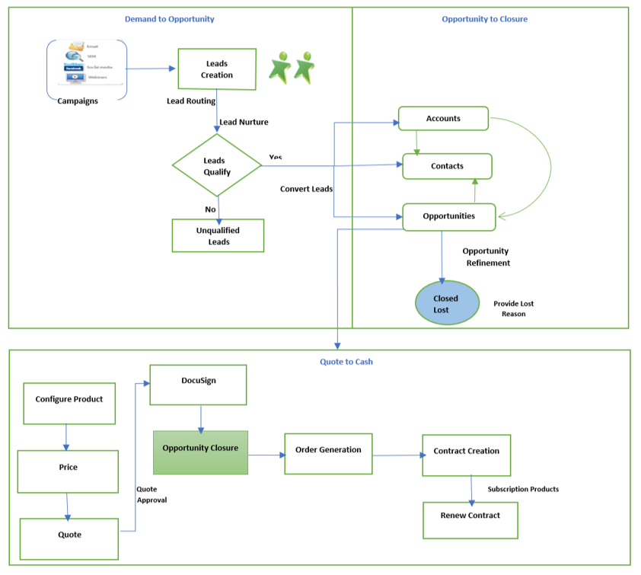
End to End Flow of Sales (continued)
11
Copyright © 2019 Deloitte Development LLC. All rights reserved.

Slide 15
Thank You
Copyright © 2019 Deloitte Development LLC. All rights reserved.

Slide 16

Salesforce Service Cloud Overview
11-MAY-2020

Slide 17
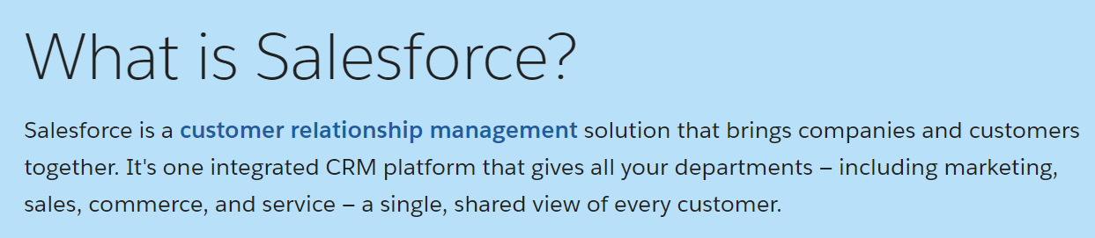
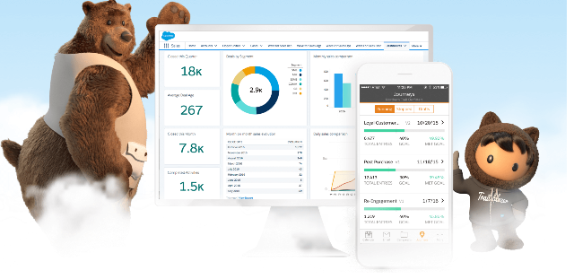
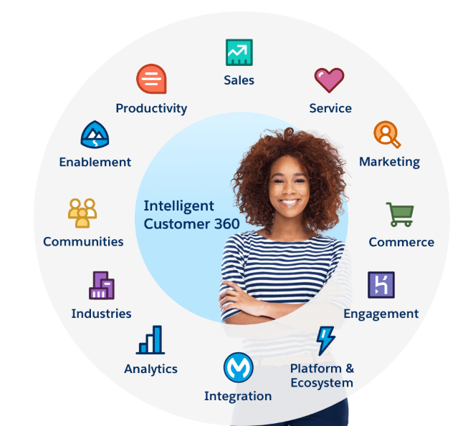
Salesforce

Slide 18

Salesforce Service Cloud An Overview
Introduction to salesforce service cloud
Salesforce Service Cloud is the “service” module (as in "customer service") module in salesforce.com.
It is a customer relationship management (CRM) platform for customer service .
It is designed to allow you to support past, current, and future clients' requests for assistance with a product, service, billing, etc.
The Service Cloud platform is a customer support platform that gives your agents superpowers to deliver service that’s as instant and easy as a conversation.
Customers can choose how to reach out and start a conversation with you, anywhere, and on any device. Email, phone, SMS, social media, online communities, or real-time web chat.
It’s seamless, and it makes it possible for your agents to deliver in-app mobile support through tools like Embedded Service and Chat.
Agents can monitor a customer’s needs and respond in whatever channel the customer feels comfortable using, including phone, email, SMS, and even Twitter or Facebook.

Slide 19



Why Service Cloud?
Delivers good customer experience – All query type captured in one place.
Simplifies agent support experience – intuitive/responsive layout/track & respond.
Supports customers everywhere – Contextual support, Multi-channel Support integrated (Email, Phone, Social Media, online communities, or real-time Web chat).
Automates assignment of queries and assign tasks – (Case assignment, notifications, escalations, milestones, service contracts, and more).
Personalizes support real time – improves agent support (Live Chat support).
Helps deflect queries & improves brand – Help customers Help themselves (Customer Communities).
Maximizes agent productivity.
Helps Streamline knowledge management processes - Find key articles, topics and experts to support users, decrease support costs.

Slide 20
Service Cloud Features
Multi-Channel Support
Service Console
Case Management & Knowledge Base
Entitlement Management
Milestone Management
Escalations- Case escalation rules
Computer –Telephony Integration (CTI)

Slide 21
Multi-Channel Support:
Web-to-Case: SFDC admins can generate HTML URL, needs to be inserted by Webmaster on Web pages.
Email-to-Case: SFDC admin can enable case creation with an email sent to a designed email address, this auto-generates a case.
Question-to-Case: This feature allows moderators (support agents) create cases from unresolved questions in Chatter, which makes it easier to track and resolve customer queries.
Moderators can create cases from questions directly in the feed. Cases from questions are added to a queue so support agents can claim them.
LiveAgent: Facilitates instant/personalized chat support to customers by support agents.
Online Communities: Communities are branded spaces for employees, customers, and partners to connect. It is customizable to suit business needs.
Note: A Salesforce Community is a website where your customers and support agents can communicate publicly or privately. It is an online forum where people help each other and get things done.

Slide 22
Multi-Channel Support : Continued
Call Center: Call Center integrates Salesforce with third-party computer-telephony integration (CTI) systems. After a CTI adapter program is installed on a Salesforce user's machine, the user can use the features of a CTI system through the Salesforce Soft Phone (making calls, receiving calls, transferring/conferencing calls, generating call logs, attaching quick view of records etc.)
Open CTI: Open CTI lets developers build CTI systems that integrate with Salesforce without the use of CTI adapters, create customizable Soft Phones that work well across multiple browsers and versions.
Social Customer Service: Social Customer Service lets you create cases or leads out of social media posts and send personalized responses on the same social media channels.
SOS: This is a mobile support solution. With SOS, customers can connect with agents over a one-way video and two-way audio chat.

Slide 23
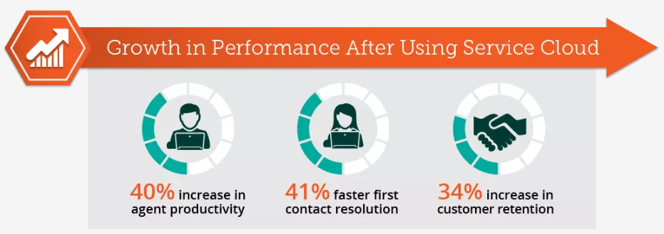
Service Console
The Service Cloud platform gives every agent a 360-degree customer view from a single screen on the Service Console.
It automatically routes cases to the right agent, at the right time. Then put all the customer information they need at their fingertips, all in one screen.
The Service Cloud platform connects sales, marketing, and customer service. So agents can always have the information they need at “Hello.”
Customers' past preferences to offer personalized incentives and special offers.
Proactively see when a product is due for service.
Ability to view service history to previous customer sales.

Slide 24
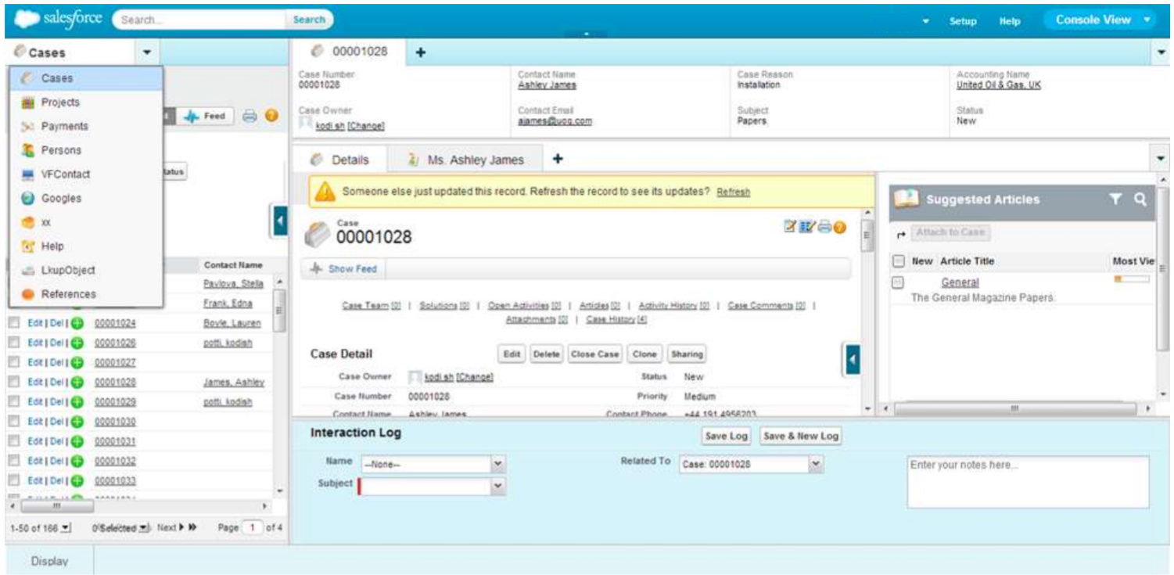
Service Console: Continued
A Salesforce console is designed to boost productivity in fast-paced service and sales environments. The console’s dashboard-like interface reduces clicking and scrolling so that agents can quickly find, update, or create records.

Slide 25

Case Management & Knowledge Base
Case Teams: Case teams help groups of people work together to solve a case, such as a support agent, support manager, and a product manager.
Case Queues: Help prioritize, distribute, and assign records to support teams. Queue members take ownership of any record in a queue. Queues are available for cases, leads, orders, custom objects, service contracts, and knowledge article versions.
Response Rules: Automatic email responses can be sent to leads or case submitters. Auto-response rules can be set to send quick replies to customers to let them know someone at the company received their inquiry or details about their issue.
Escalation Rules: Case escalation rules can be created to escalate cases automatically if they are not resolved within a certain period of time.
Assignment Rules: Organizations can define conditions that determine how leads or cases are processed/routed.

Slide 26
Case Management & Knowledge Base: Continued
Omni-Channel: It is a customer service solution that lets call center route cases, chats, or leads to the most qualified, available agents in your organization. You can define which agents can work on different types of assignments. One group of agents to respond to leads and sales inquiries, and another group that helps customers with support questions.
Omni-Channel routes all these assignments to the correct agents automatically. Agents no longer have to pick and choose work assignments manually from a queue.
Macros: You can create a macro by specifying the instructions for actions that the macro performs. A macro is like a little computer program. You need to tell the macro each step that it performs.
Knowledge Base: Support teams can leverage knowledge articles (FAQs) to help resolve common issues authored by domain experts/customer support representatives on the fly. This can be linked to the subject of the query raised.

Slide 27
Case Lifecycle
“Lifecycle" refers to the various statuses (New, Open, Pending, Resolved, Closed)
Case is first created: When a case is first created, it automatically gets a status of New. Once the status changes from New, it can never revert back to that status.
Case Creation (Web2case)
Gather customer support requests directly from your company’s website and automatically generate new cases with Web-to-Case. Setting up Web-to-Case involves enabling the feature, choosing settings, and adding the Web-to-Case form to your website.
Case Creation (Email2Case)
Email to case agent is installed on your local/Server System. It fetches message from your email Server (Email address dedicated to Email to Case), process it and creates Case records inside Salesforce.
Agent opens the case: When an agent opens a case for the first time, the status of the case changes to Open. Note that when an Agent opens a case it will be locked for other Agents - meaning they can still view the case but won't be able to edit it, since the Agent that opened the case is already active on it.

Slide 28
Case Lifecycle: Continued
Agent replies to case: After an agent sends a reply to a customer, the status should be changed to Pending or Resolved. This can be done manually by Agents or automatically by Rules.
Customer replies to Pending or Resolved case: If a customer replies to a case that is set to Pending or Resolved, the case will revert back to Open, due to a default Inbound Interaction rule - Re-open Pending or Resolved Cases. Setting the case back to Open causes the case to be routed to an agent and/or appear in the appropriate case filters.
Case is closed by a Rule: A case can only be set to Closed by a Rule.
Once a case is Closed, it becomes read-only and the status cannot be changed. So if there is any chance that the case may need to be updated again at some point, you should not allow it to be set to Closed.
If a customer replies to a case that is set to Closed, a new case will be created.
If you do want to set cases to Closed, the recommended practice is to use a Time Rule to automatically close cases that are set to Resolved but have not been updated for some time. Desk.com comes with a default Time Rule - Close Case, that does this but it is disabled by default.

Slide 29
Entitlement Management
Entitlement Process : Entitlement processes are timelines that include all the steps (or milestones) that your support team must complete to resolve support records like cases or work orders. Each process includes the logic necessary to determine how to enforce the correct service level for your customers.
Example: Maybe high-priority cases must be closed within 24 hours, or agents must respond to customer comments on cases within 4 hours. To enforce time-dependent support steps like these on cases, you can use a nifty tool called an entitlement process.
Entitlement Management: Entitlement management is just a blanket term for a group of Salesforce features that help you enforce service level agreements (SLAs), which are contracts that spell out the level of service you’ve promised to your customers.

Slide 30
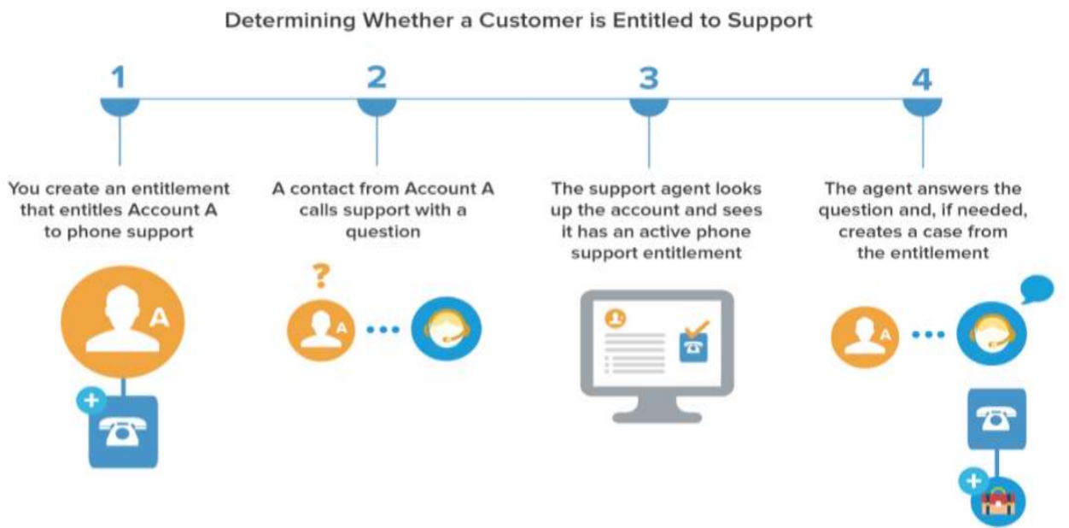
Entitlement Management: Continued

Slide 31
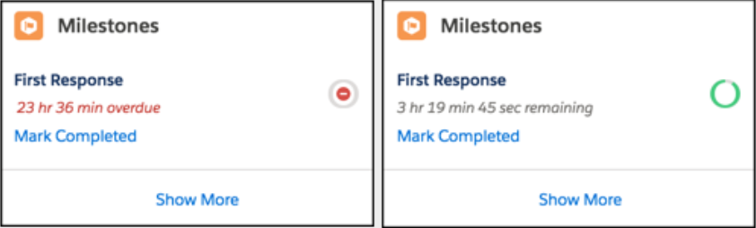
Entitlement Management: Continued
Entitlement processes are customizable timelines that include all of the steps (or milestones, in Salesforce lingo) that support agents must complete to resolve a case.
Milestone : Milestones represent required, time-dependent steps in your support process, like first response or case resolution times. Milestones are added to entitlement processes to ensure that agents resolve support records correctly and on time.

Slide 32
Entitlement Process : Continued
To enforce time-dependent support steps on cases, we have a nifty tool called an entitlement process.
Entitlement processes are customizable timelines that include all of the steps (or milestones, in Salesforce lingo) that support agents must complete to resolve a case.
Once we set up a process, we can apply it to as many customer entitlements as we need.
An entitlement process needs milestones to represent required support steps; otherwise, it’s just an empty framework.
If a product that we offer includes the same support level for every customer, we can attach an entitlement template to the product to predefine its support terms.
Once entitlement and entitlement process is set, agent can create a case from entitlement and all the setting will apply to the case.

Slide 33
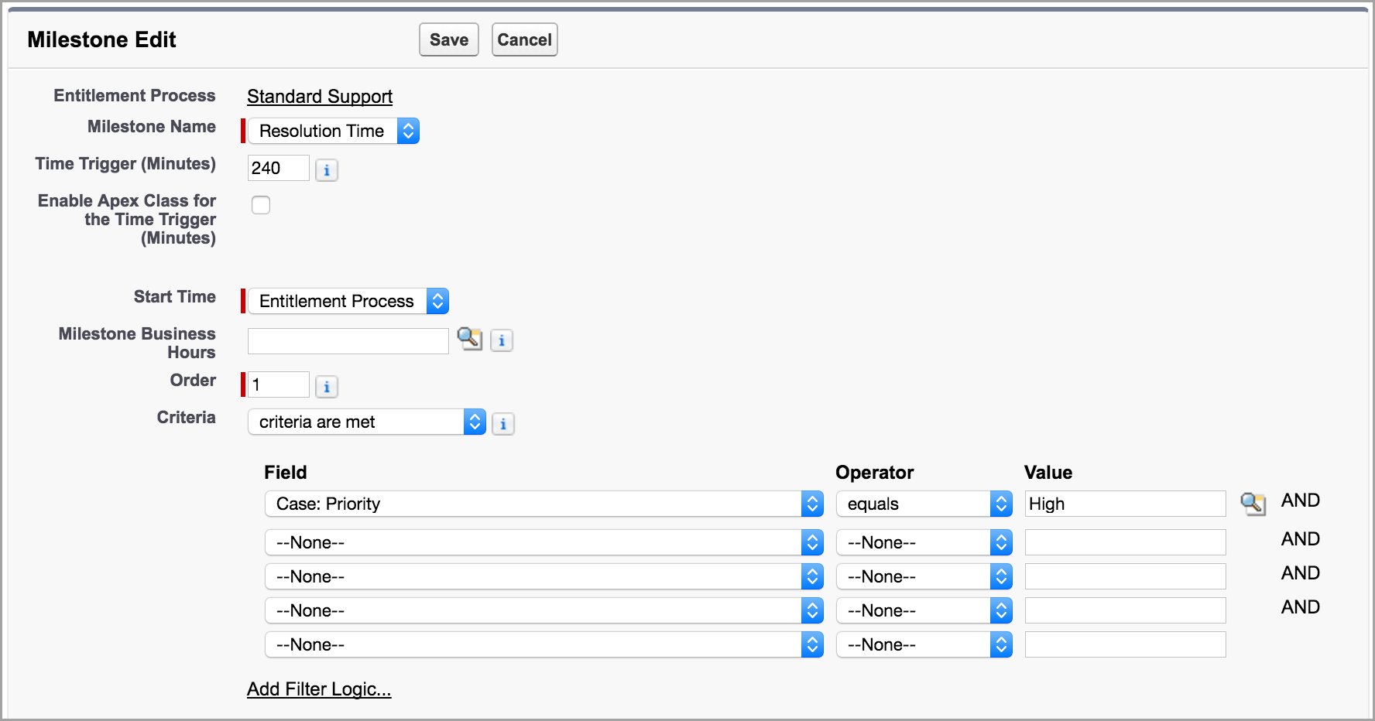
Milestone Management
Milestones represent required steps in our support process, such as case resolution time and first response time.
We create master milestones in our org and then add them to entitlement processes to enforce different service levels on support records, like cases and work orders.
We can have multiple milestones on an entitlement process and set them by adding an order to showcase which one appears first.

Slide 34
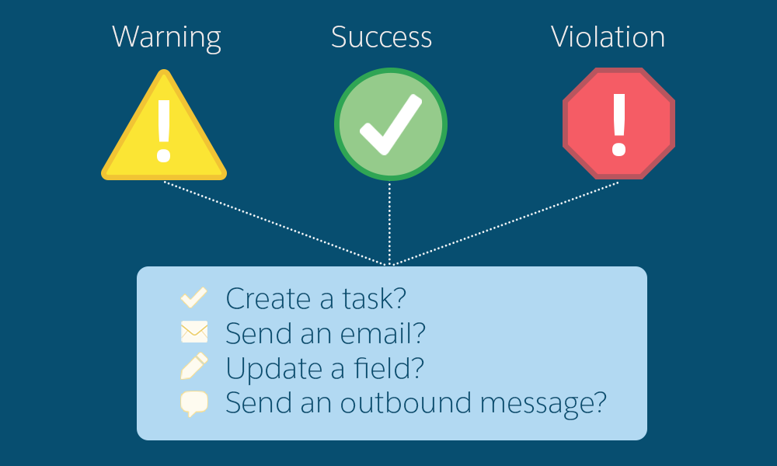
Milestone Management: Continued
To keep agents in the know, a milestone workflow action can be added that warns agents when an open high-priority case is approaching the resolution time limit.
A time can be set before which the warning should appear on the screen with the workflow of what the agent must do in order to complete the milestone.
On similar lines, we can set for violation and success cases.

Slide 35
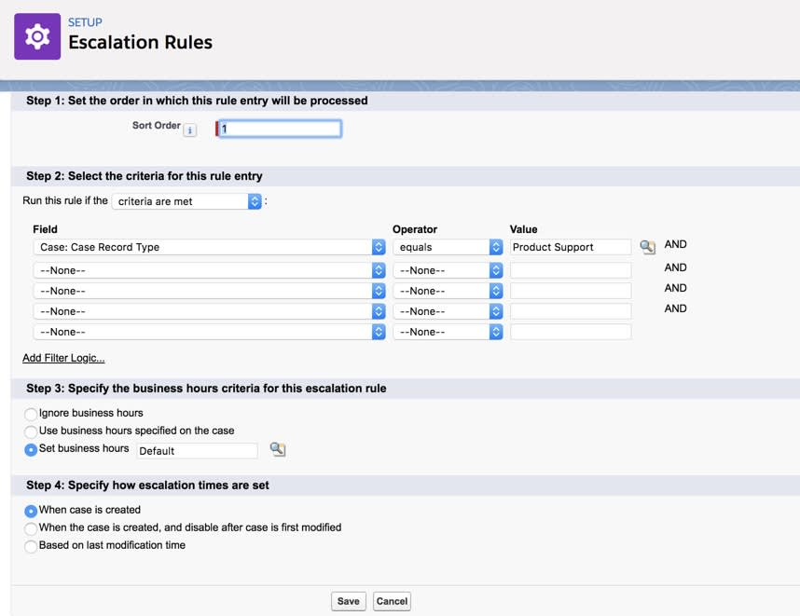
Escalation Case Escalation Rule
With case routing criteria in place, Salesforce wants to ensure that they have a way to catch cases that are open for an extended period of time and escalate them to a team that deals with the high priority cases.
To accomplish this, create a standard case escalation rule. And looks like this:
These details can be edited also post creation.
It is customizable and can be set based on project requirements.

Slide 36
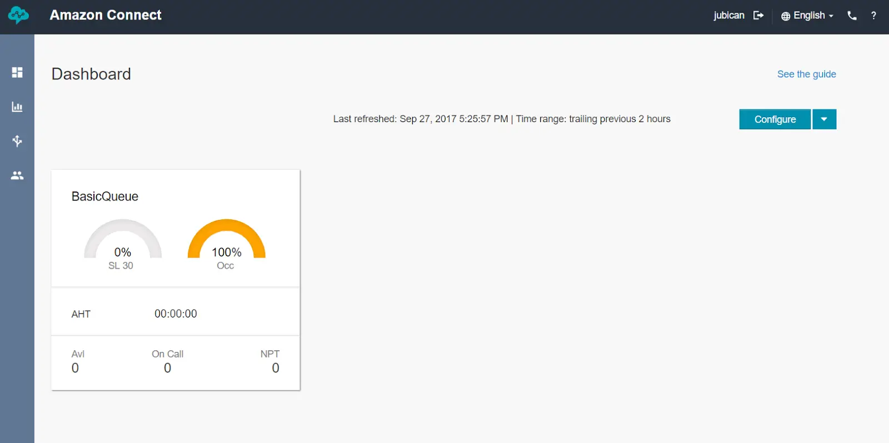
Computer-Telephony Integration (CTI)
Understanding Amazon Connect Instance Dashboard
Using Amazon Connect access URL, one can log in to Amazon Connect instance using the Administrator credentials.
There is a queue created by default but we can add other queues by clicking Configure.
One can also change performance metrics and time ranges specific to one’s business requirements.
On the navigation bar to the left, there are three menus: Metrics and quality, Routing, and Users.
Metrics and quality provides real-time and historical metrics. We can also look up metrics for specific users.
Routing allows us to change how our contact center works, from call flow to queues.
Users gives us the ability to create profiles, users, security, and status.

Slide 37
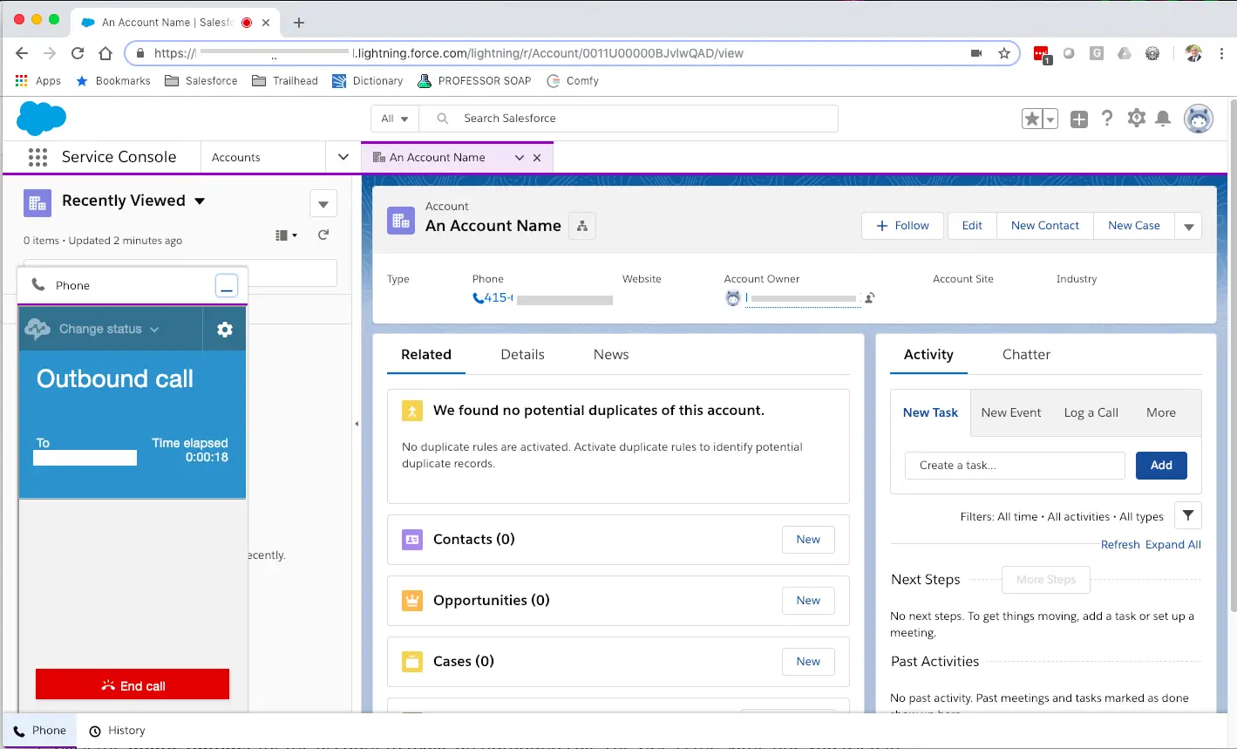
Continued:
Call Flow in Salesforce Service Cloud CRM
Amazon Connect provides the telephony services used by the call center profile in Salesforce Service Cloud.
These services allows to place outbound phone calls and receive phone calls directly in Salesforce.
By opening any Account via Service console, one can leverage the click-to-call capability when the icon or number is pressed.

Slide 38
Service Cloud Limitations
Feature | Limitations
Email to Case | The limit on the number of emails a day that an organization can convert into cases is 2,500 per day for Professional, Enterprise, Unlimited, and Developer Editions.
Web To case | 5,000 cases in a 24–hour period. Rich text area (RTA) fields not supported on W-t-C forms.
Live Agent Chat/Console | No Chat Support No critical wait alert times Cannot transfer files No supervisor features
Entitlements | Milestones can’t be added to cases without using entitlement processes. Entitlement processes apply milestones to cases. An org can have up to 1,000 entitlement processes, with up to 10 milestones per process. Entitlement contacts don’t have page layouts, search layouts, buttons, links, or record types.

Slide 39
Service Cloud Limitations: Continued
Feature | Limitations
Communities | Max 50 communities. 40 GB – production Partner 300 K Customer 10 Million Portal roles 5000
Social Customer Service | Maximum number of active managed social accounts: 500 Accounts Maximum number of post tags: 200
SOS | Windows or BlackBerry mobile OS not supported Does not support Safari or IE Requires greater than 3G Networks Agent initiated SOS sessions SF1 not supported

Slide 40
Any Open Questions??

Slide 41


